Slide 1

COVID19
Real time epidemic modelling

Slide 2
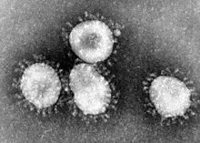
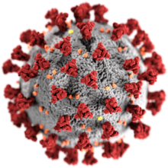
CoronaViruses
Coronaviruses are an extremely common class of virus.
Responsible for a number of illnesses including the common cold, pneumonia, gastroenteritis
Infect birds and mammals. Many harbor variants asymptomatically.
Named for spike proteins resembling solar coronas : corona (Latin) “crown” or “wreath”
We don’t know much about these viruses.
Coronavirus outbreaks can happen anywhere, any time.
SARS (2002) and MERS (2012) were most recent epidemics
Government & global health orgs routinely drill coronavirus emergencies
COVID19 should not be surprising -- more or less inevitable and no one’s fault

Slide 3
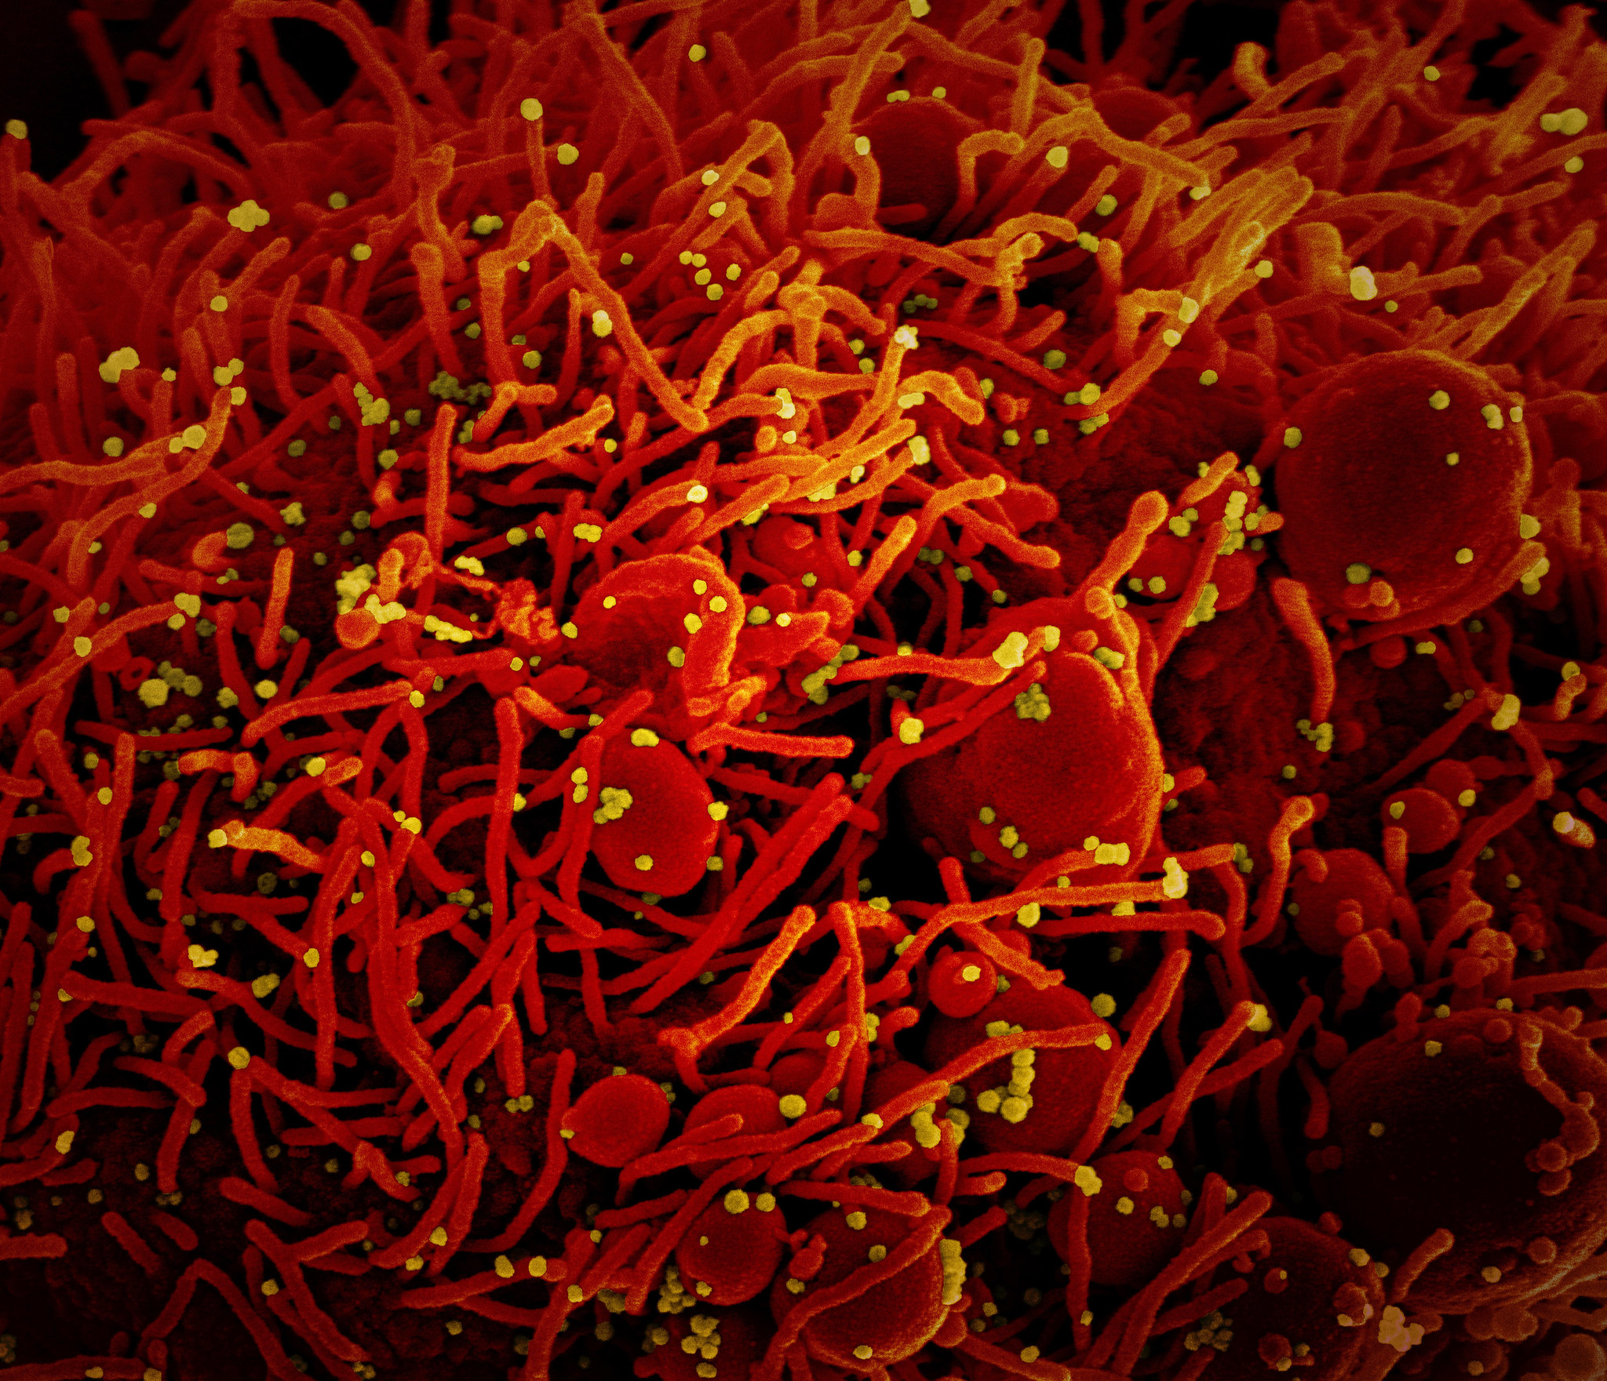
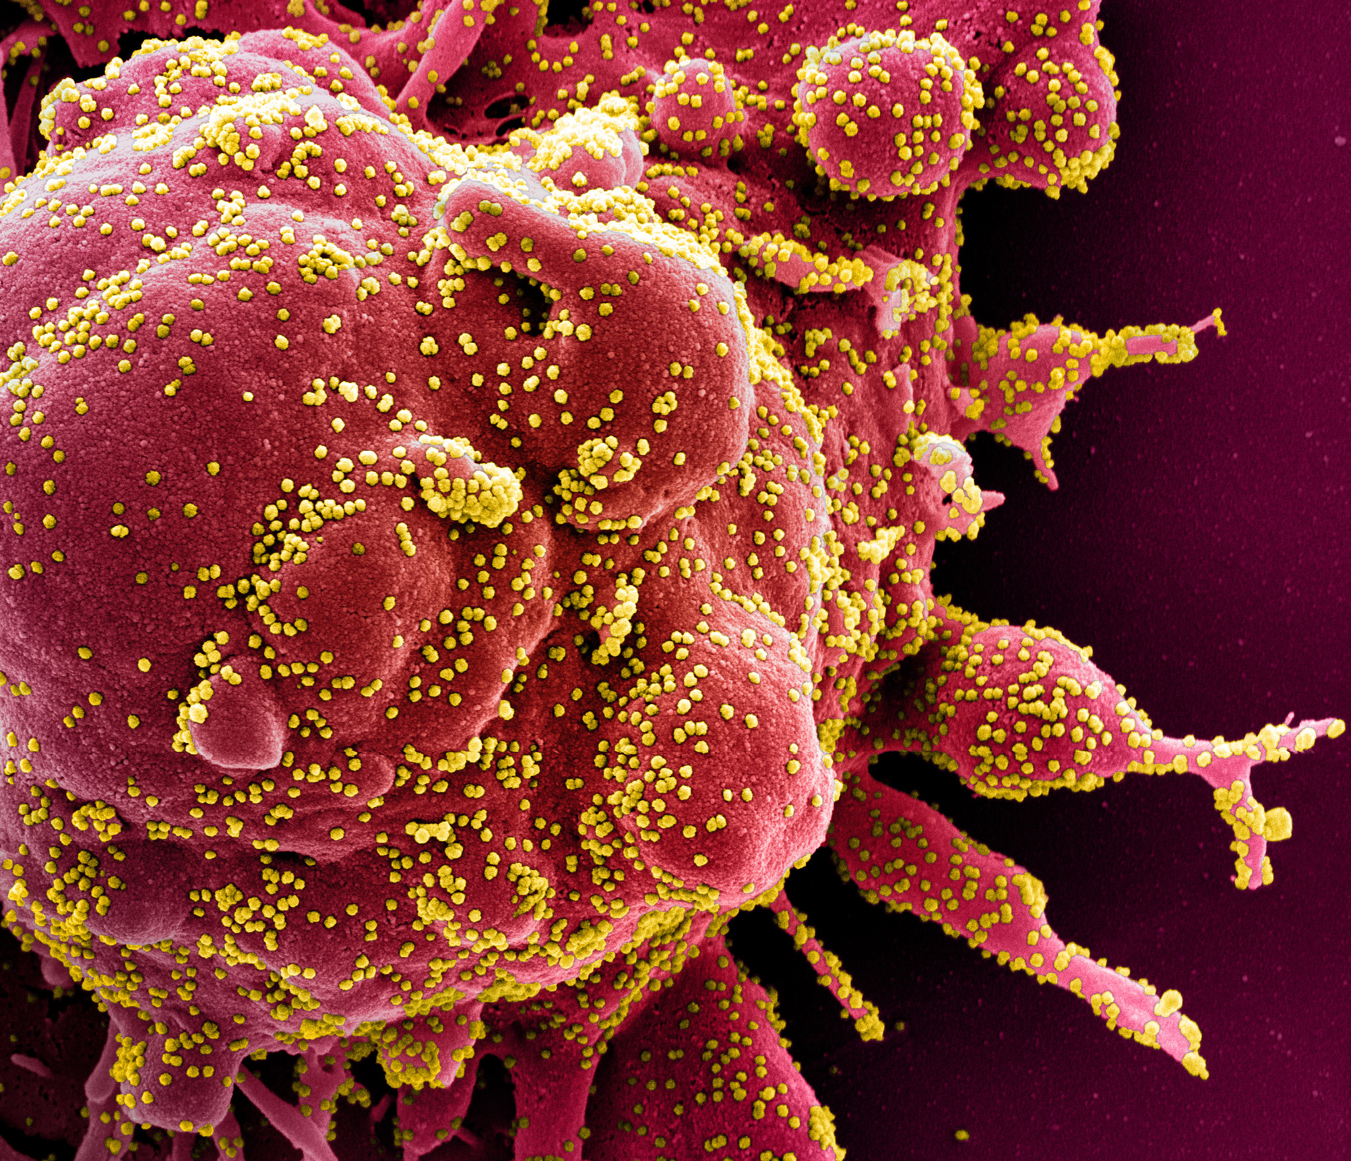
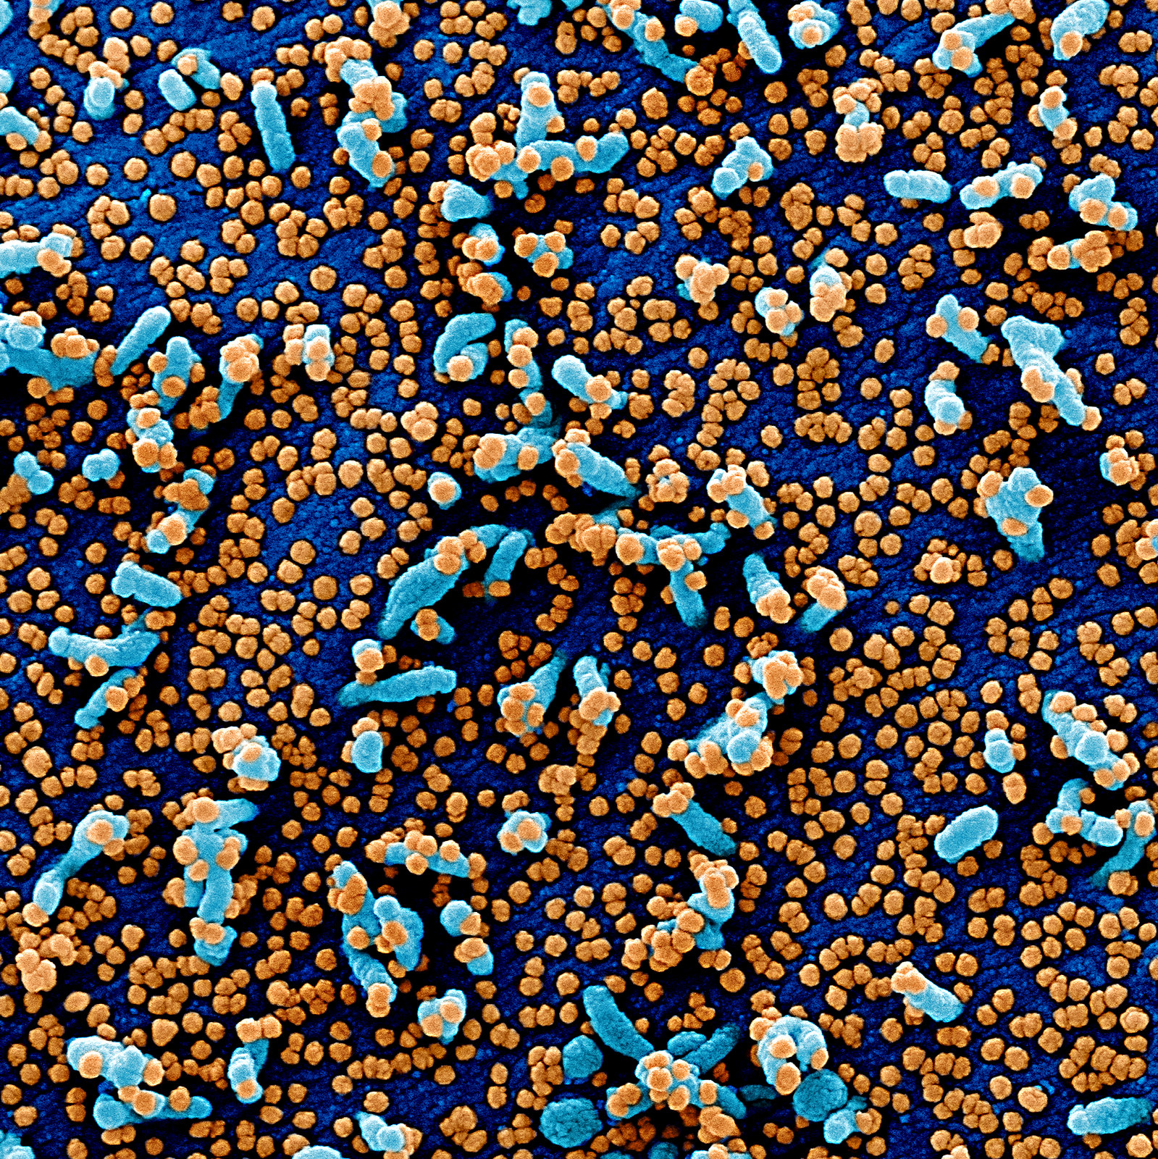
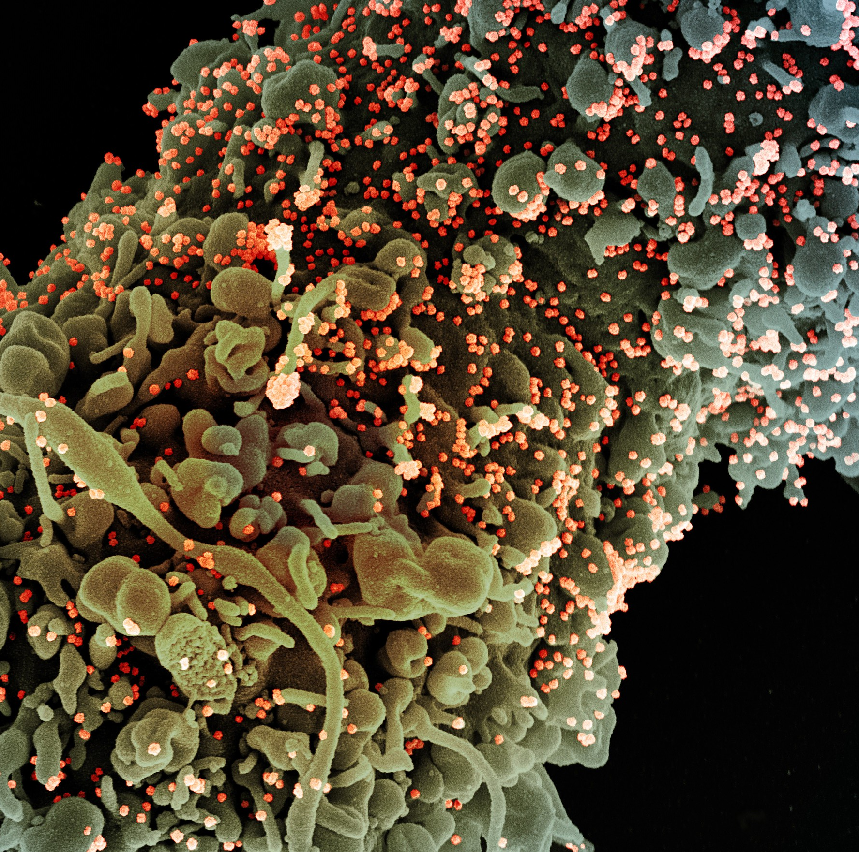
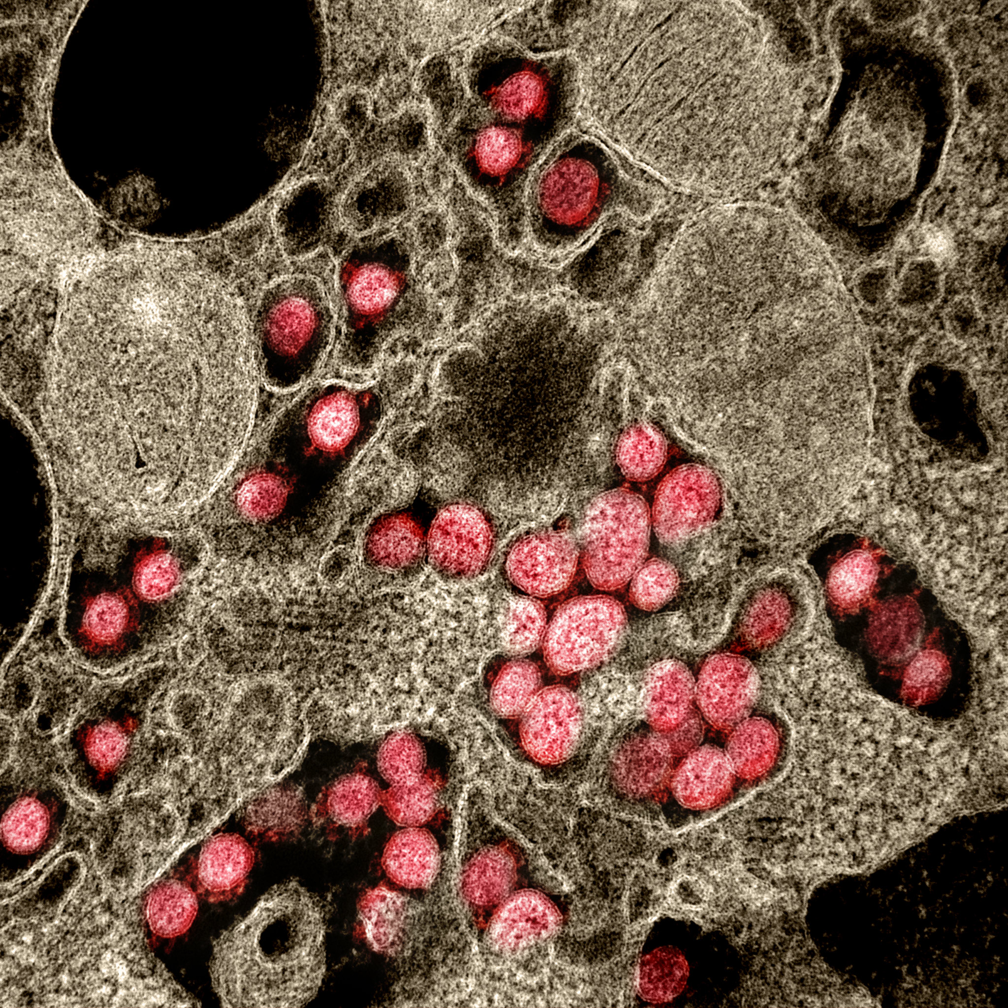
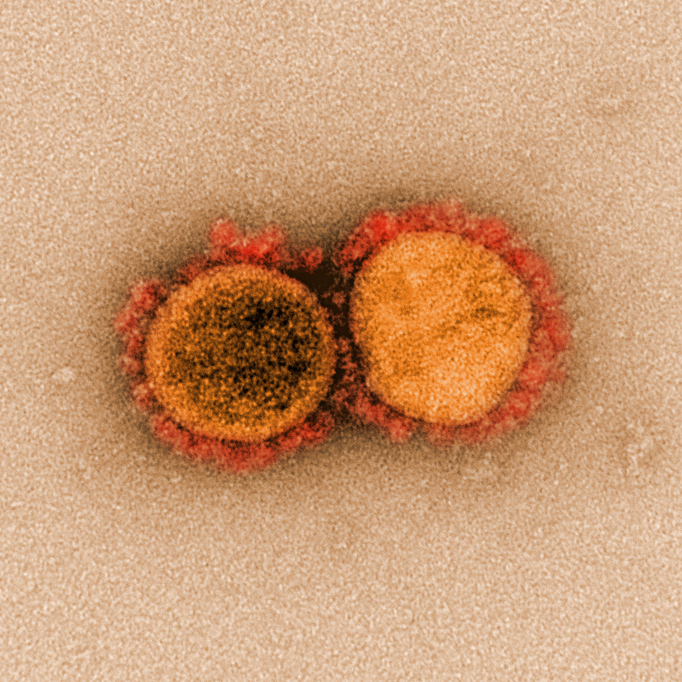
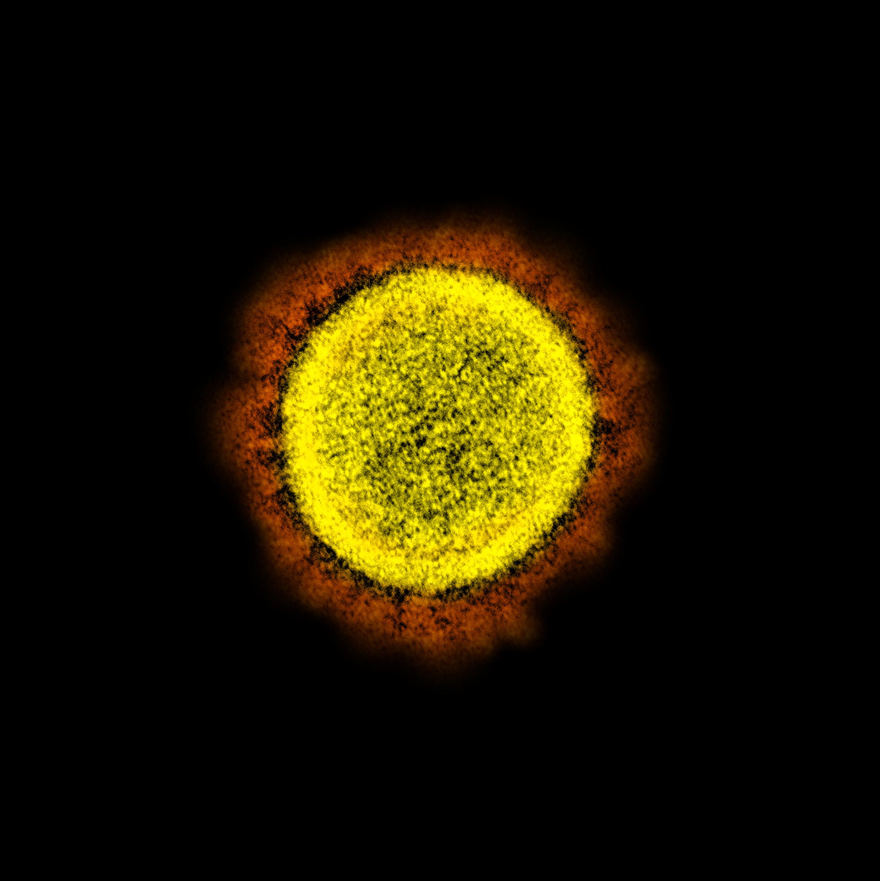
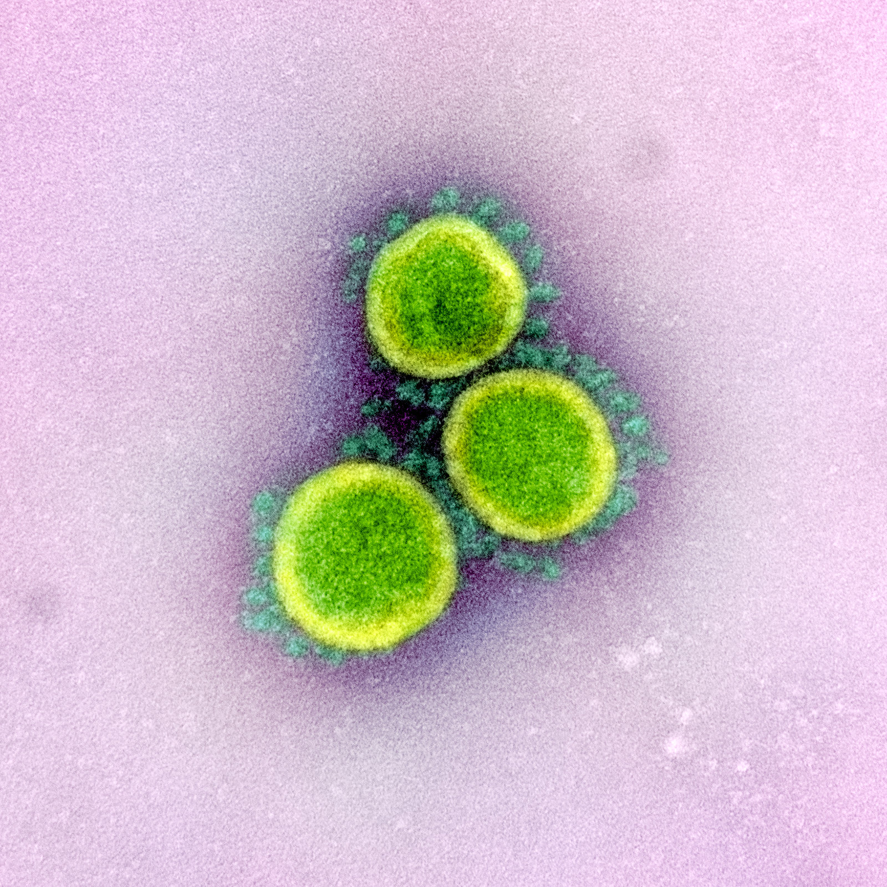
CoronaViruses

Slide 4
Situation Report
The COVID19 pandemic originated near Hubei province, China sometime around November 2019 according to phylogenetic analyses.
The first identified case occurred in December 2019 in Wuhan.
As of today there are:
2,543,327 cumulative confirmed cases
176,527 cumulative deaths
686,440 recoveries

Slide 5
The Life of a virus
A quick review of introductory concepts

Slide 6

One Grain of Rice a mathematical Folktale by Demi

Slide 7


One virus
A single virus can initiate an infection if it finds the target cell.
For SARSCoV2, target cells are those containing “ACE2” receptors that react with the external spike proteins.
These are generally lung, sinus or gastrointestinal membrane cells.

Slide 8
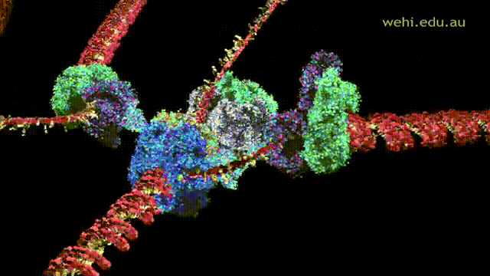
One virus
After infiltrating the cell, it tricks it into replicating its RNA and assembling many copies of the virus.
Mistakes made during this process
can lead to mutations

Slide 9
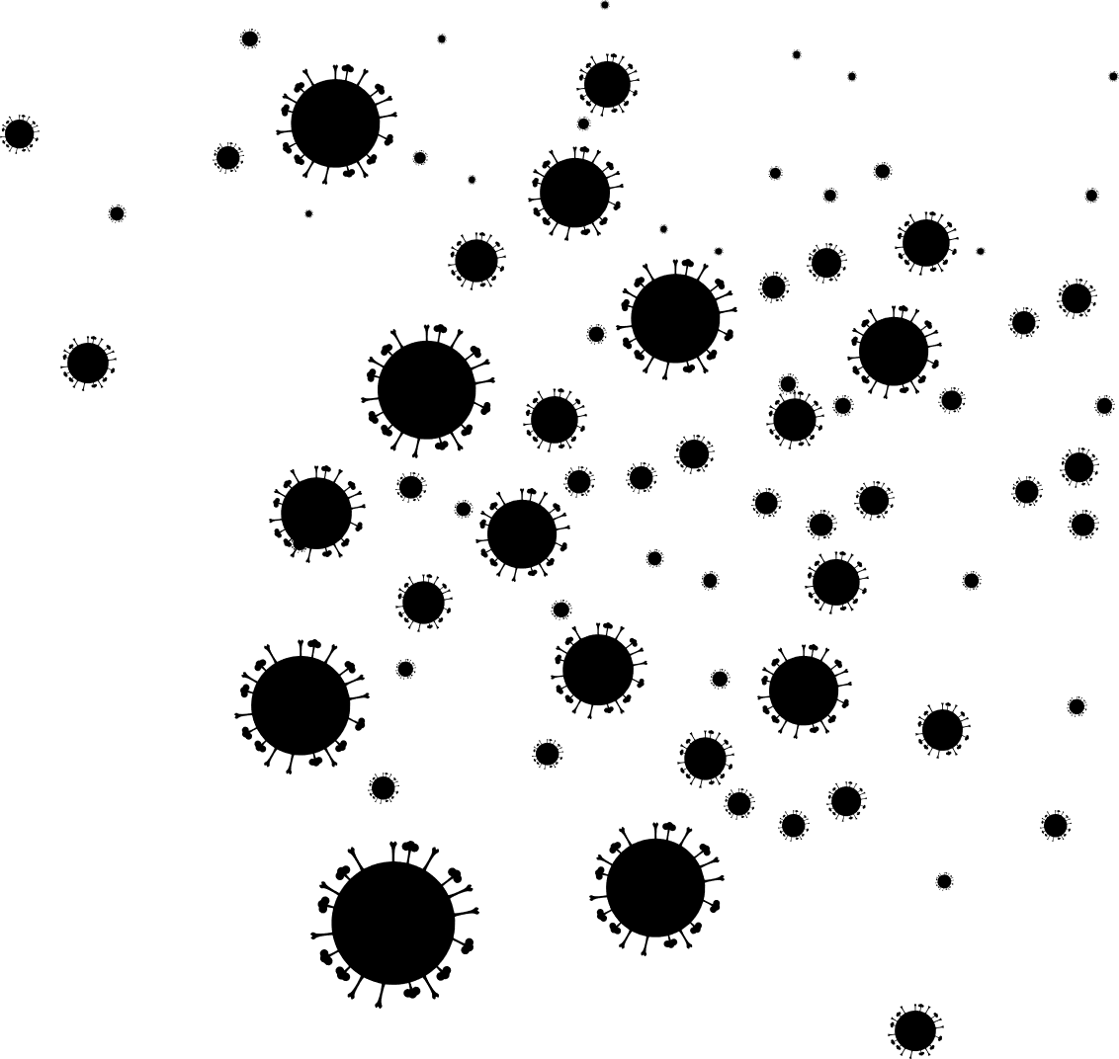
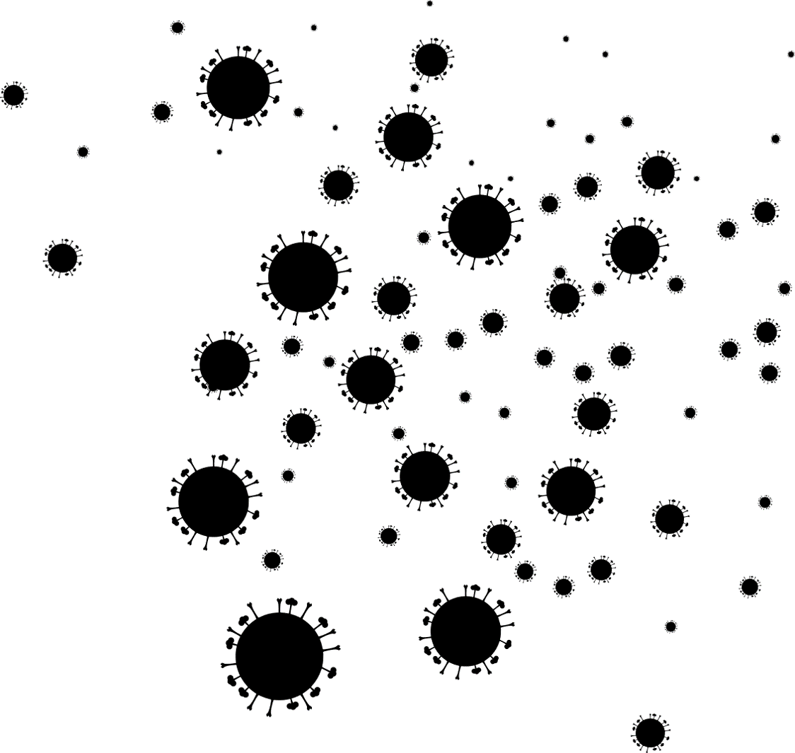
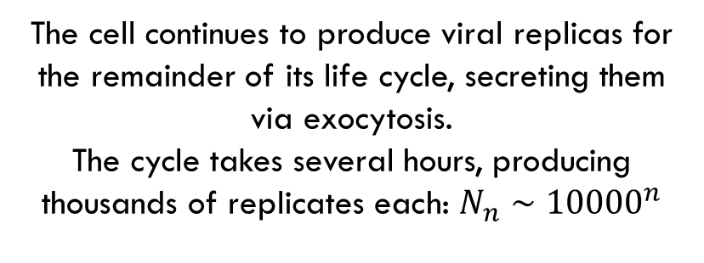
One virus
The cell continues to produce viral replicas for the remainder of its life cycle, secreting them via exocytosis.
The cycle takes several hours, producing thousands of replicates each: $N_{n}∼{10000}^{n}$

Slide 10

One virus

Slide 11
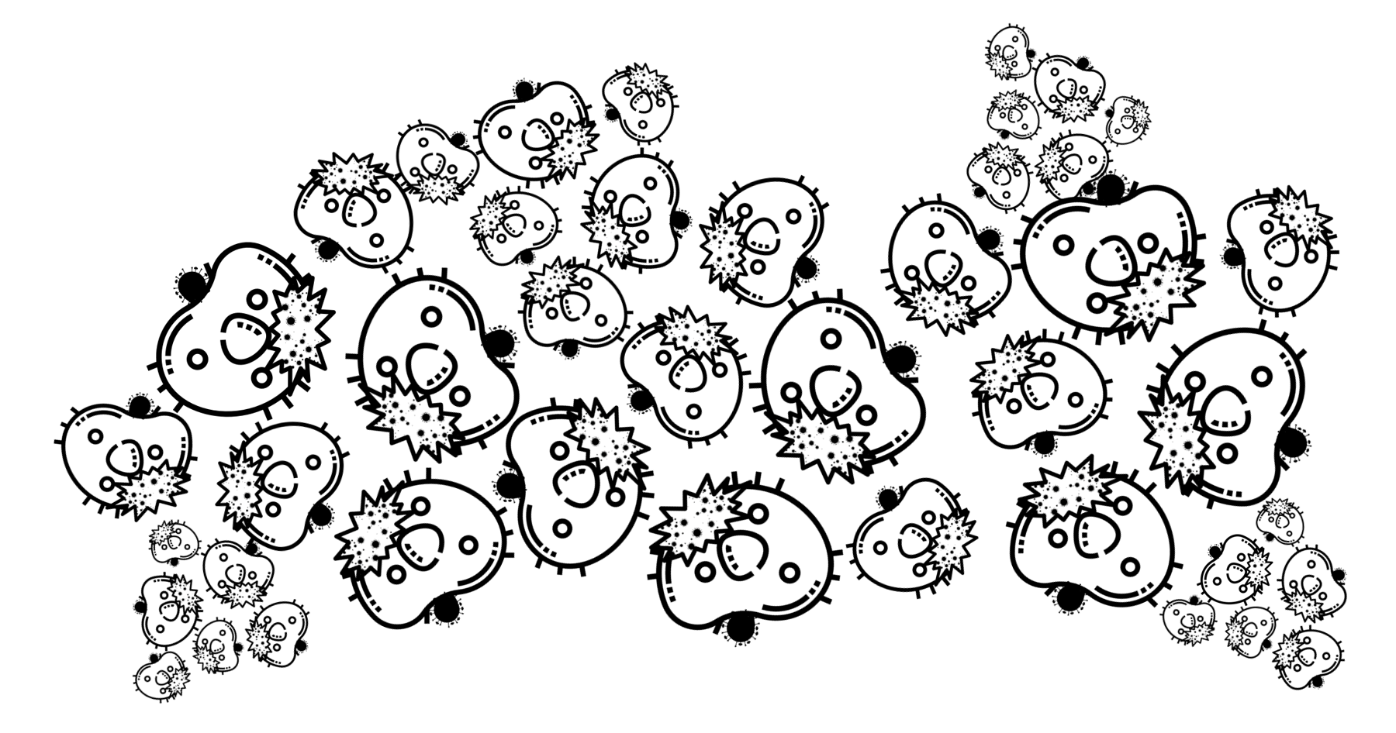

One virus

Slide 12


Slide 13

One Person
It takes between 3-14 days for symptoms to develop, dependent on a number of factors, possibly including but not limited to: initial viral load, individual immune response, blood type, infection pathway

Slide 14
One Person
Let’s assume that over the course of the infection, one person transmits the virus to three new people on average.
We’ll take the course of infection to be one week for simplicity
1 week

Slide 15

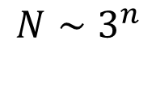
One Person
Early in the epidemic, infected grow exponentially in time!
$${N∼3}^{n}$$
1 week

Slide 16
One Person
Compare shape to real data from
Johns Hopkins
(https://github.com/CSSEGISandData/COVID-19)

Slide 17
One Person
Compare shape to real data from
Johns Hopkins
(Better to plot Logarithmically)

Slide 18
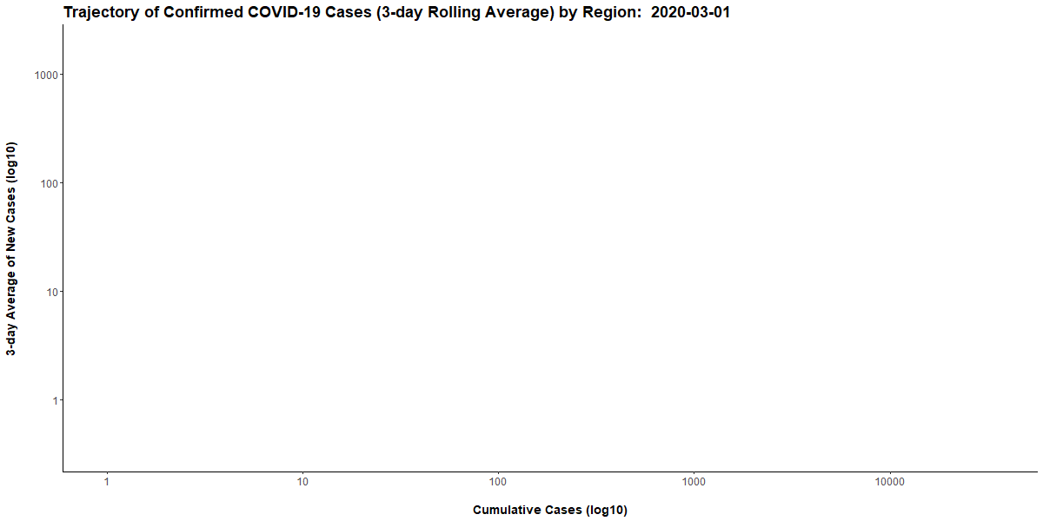
Questions
Finite number of humans on Earth!
Can’t exponentially grow indefinitely – what is late phase behavior?
What most significantly affects this trend?

Slide 19
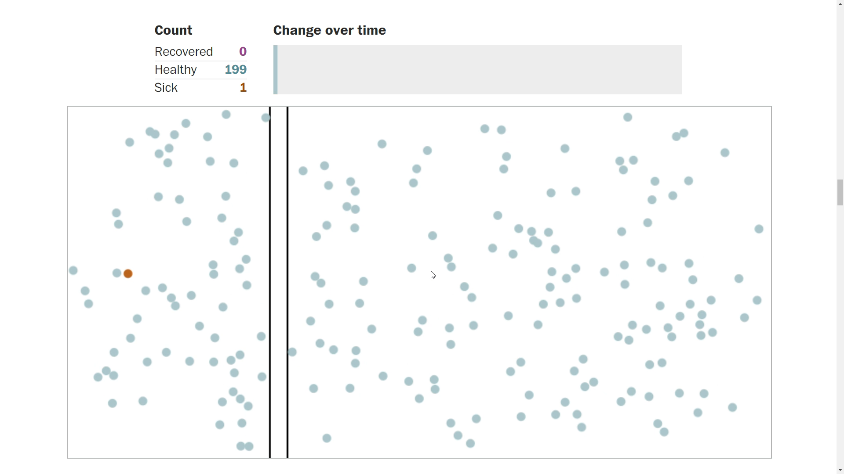
Questions
How can we understand interventions?
How do different interventions change behavior?
When and under what conditions are different interventions effective?

Slide 20
Questions
Finite number of humans on Earth!
Can’t exponentially grow indefinitely – what is late phase behavior?
What most significantly affects this trend?
How can we understand interventions?
How do different interventions change behavior?
When and under what conditions are different interventions effective?
What lies in the far future?
Why are some diseases endemic – i.e. return periodically – like the flu? Will COVID19 become endemic?

Slide 21
Modeling Epidemics
Growth, Spread, Diversity

Slide 22
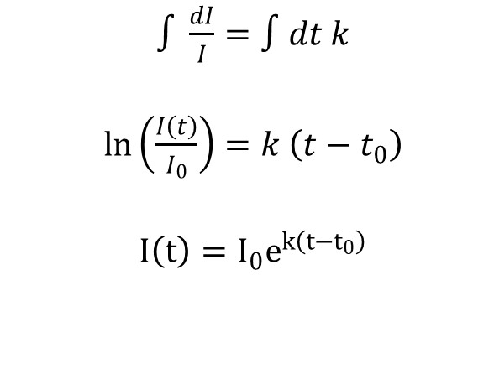
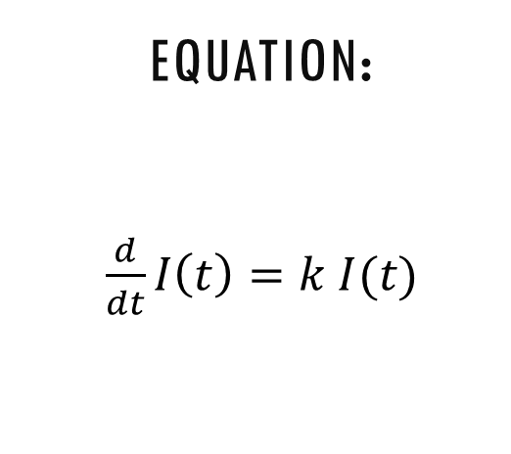
Simple Epidemiology
Starting Point: Simple exponential growth
First equation you solve in an ODE course: Change in population is proportional population size
Equation:
$\frac{d}{dt}I\left(t\right)=k I(t)$
Solution:
Plot:
$∫\frac{dI}{I}=∫dt k$
$\ln\left(\frac{I\left(t\right)}{I_{0}}\right)=k \left(t−t_{0}\right)$
$I\left(t\right)=I_{0}e^{k\left(t−t_{0}\right)}$

Slide 23
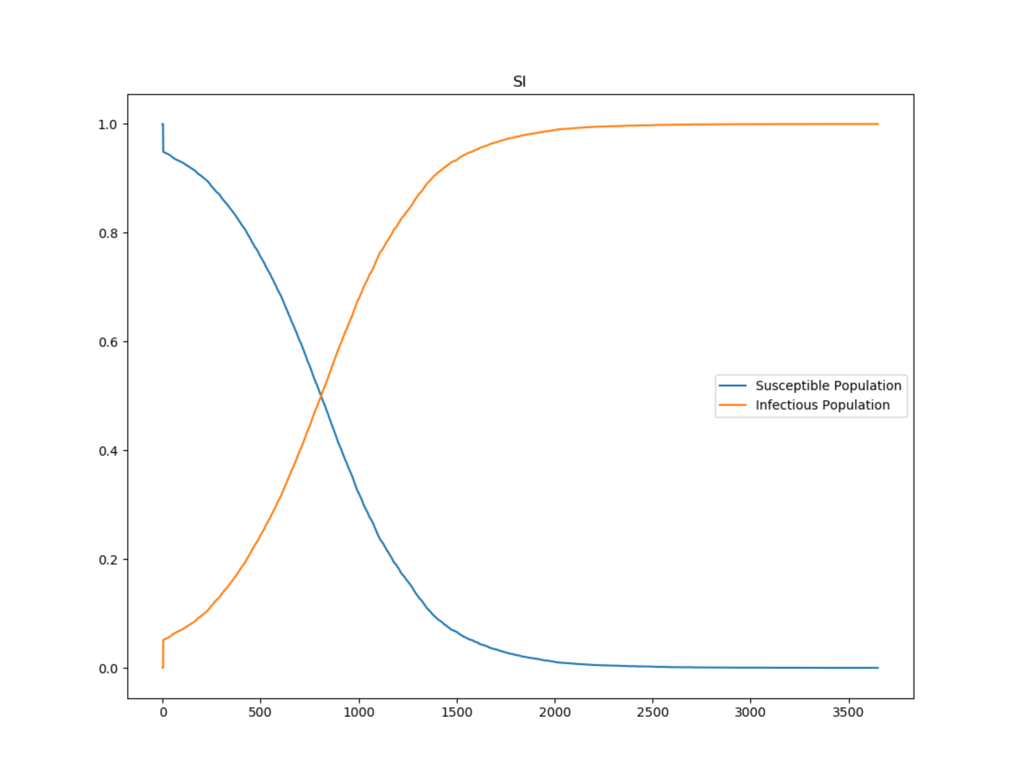
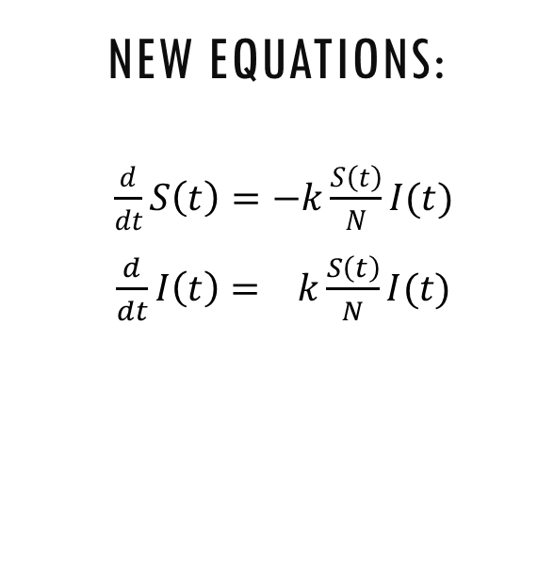
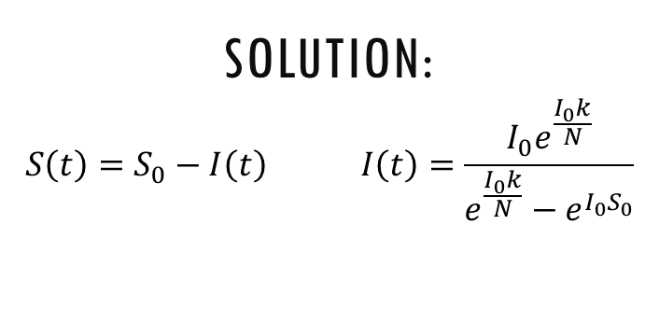
Simple Epidemiology
Correction 1: Unrealistic Numbers of New Infections!
The number of people “susceptible” to the virus monotonically decreases with infection!
Strategy:
Keep track of them with S(t)
Increase in I(t) ∝ S% and I(t)
I’ = - S’
New Equations:
$\frac{d}{dt}S\left(t\right)=−k\frac{S\left(t\right)}{N}I(t)$
$\frac{d}{dt}I\left(t\right)= k\frac{S\left(t\right)}{N}I(t)$
Solution:
$$S\left(t\right)=S_{0}−I\left(t\right) I\left(t\right)=\frac{I_{0}e^{\frac{I_{0}k}{N}}}{e^{\frac{I_{0}k}{N}}−e^{I_{0}S_{0}}}$$

Slide 24
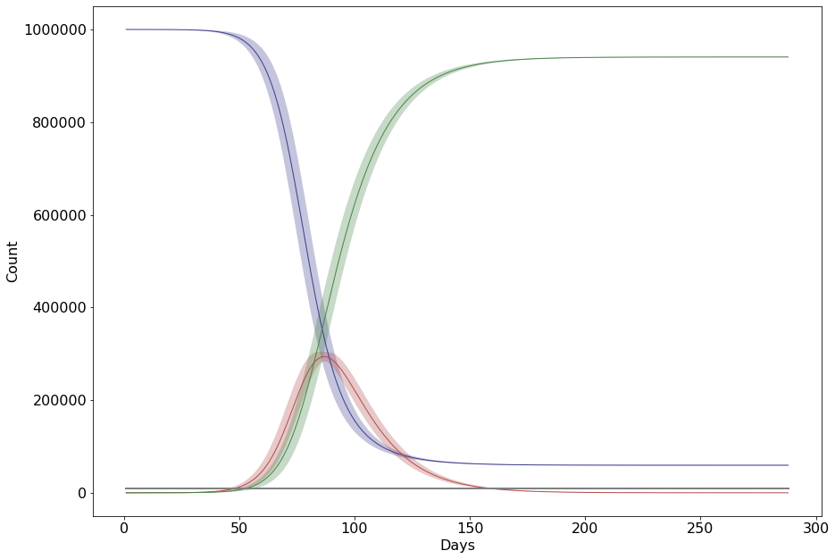
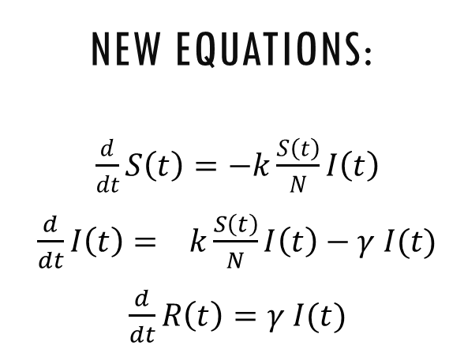
Simple Epidemiology
Correction 2: Unrealistic Numbers of Old Infections!
The number of infected decreases via recovery or death!
Strategy:
Keep track of them with R(t)
Decrease in I(t) ∝ I(t)
Increase in R(t) ∝ I(t)
New Equations:
$\frac{d}{dt}S\left(t\right)=−k\frac{S\left(t\right)}{N}I\left(t\right)$
$\frac{d}{dt}I\left(t\right)= k\frac{S\left(t\right)}{N}I\left(t\right)−γ I(t)$
$\frac{d}{dt}R\left(t\right)=γ I(t)$
Solution:
Nonlinear: No general solution!

Slide 25
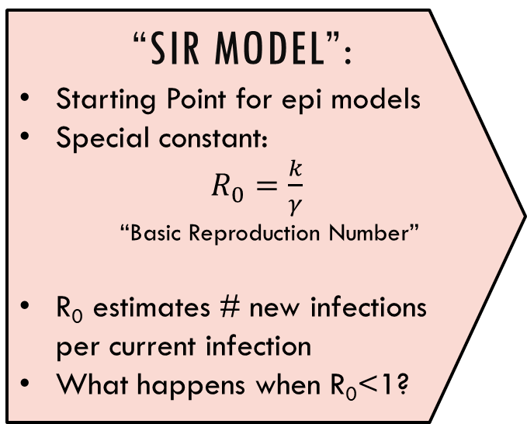
Simple Epidemiology
Correction 2: Unrealistic Numbers of Old Infections!
The number of infected decreases via recovery or death!
“SIR Model”:
Starting Point for epi models
Special constant:
$R_{0}=\frac{k}{γ}$
“Basic Reproduction Number”
R₀ estimates # new infections per current infection
What happens when R₀<1?
New Equations:
$\frac{d}{dt}S\left(t\right)=−k\frac{S\left(t\right)}{N}I\left(t\right)$
$\frac{d}{dt}I\left(t\right)= k\frac{S\left(t\right)}{N}I\left(t\right)−γ I(t)$
$\frac{d}{dt}R\left(t\right)=γ I(t)$
Solution:
Nonlinear: No general solution!

Slide 26
Simple Epidemiology
Correction N: Lots of variations!
Lots of variations to study— invent your own or visit Wikipedia “Compartmental Models in Epidemiology”
Realism:
Exposed + Age classes
Spatial diffusion
Random R₀
Seasonal Forcing
Mutant spread (*)
Mitigation:
Quarantine Measures
Contact Tracing
Vaccination
Herd immunity
Forecasting:
Resurgent Waves from Imports
Containment v.s. Endemic (*)

Slide 27
Simple Epidemiology
Numerical Methods!
There are many ways to numerically integrate differential equations
Runge Kutta:
Discretize time step
Approximate short time trajectory using derivatives
Many, many tutorials online
Exponential Integrator:
Allows evaluating unstable numerical solutions which would otherwise need extremely small time steps
Good for SIR models with interactions that happen on different time scales
Built in Methods:
If you use a built in method (such as Pythons ODEint) you must not only read the documentation, but also describe how it works and where it my fail
If you use a built-in method, you are expected to produce high-quality analysis

Slide 28
Simple Epidemiology
Important points:
The SIR model is a “Mean Field” equation: best applicable to large, dense cities
Does not capture random stochastic behaviour, or directly tell you about variance
Long term predictions are likely qualitatively wrong, especially when ignoring spatial diffusion*
*(the model has an upper critical dimension of 2 – a subtle technical point beyond the scope of undergraduate level courses!)

Slide 29
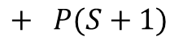
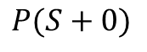
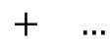
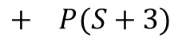
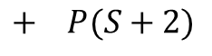
Epidemiology Cont’d
Defining a Microscopic Model: Real life is stochastic
A more realistic simulation needs to account for randomness.
$$P(S+0)$$
$$+ P(S+1)$$
$$+ P(S+2)$$
$$+ P(S+3)$$
$$+ …$$
Many outcomes with different probabilities!

Slide 30
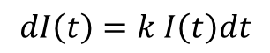
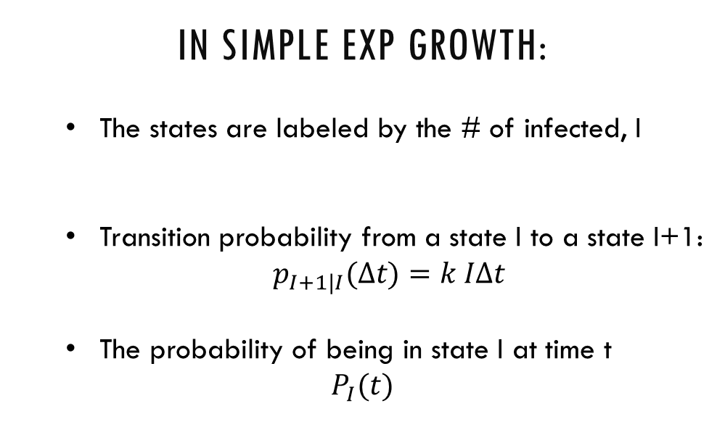
Epidemiology Cont’d
Revisit simple exponential growth Let’s learn to define a model stochastically through a master equation. Recall:
$$dI\left(t\right)=k I\left(t\right)dt$$
Components of a Stochastic Model:
A set of possible states
Probability per unit time (rate) of transitions between two given states
Probability of being in a given state
In simple Exp growth:
The states are labeled by the # of infected, I
Transition probability from a state I to a state I+1:
$p_{I+1|I}(Δt)=k IΔt$
The probability of being in state I at time t
$$P_{I}(t)$$

Slide 31
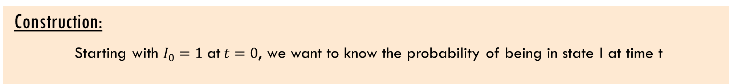
Epidemiology Cont’d
Construction:
Starting with $I_{0}=1$ at$t=0$, we want to know the probability of being in state I at time t
Markov Assumption: This can only depend on the state of the system immediately before time t
$$P_{I}\left(t\right)=?$$

Slide 32
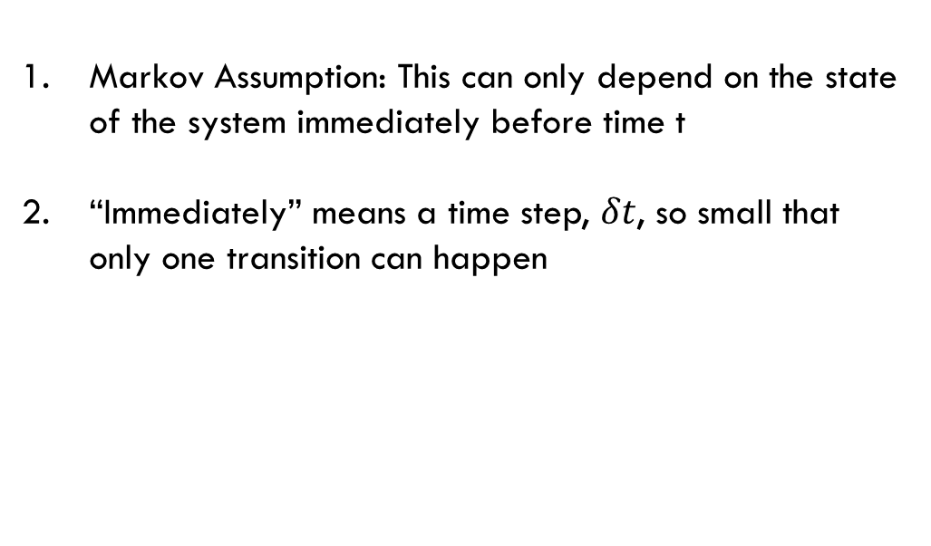
Epidemiology Cont’d
Construction:
Starting with $I_{0}=1$ at$t=0$, we want to know the probability of being in state I at time t
Markov Assumption: This can only depend on the state of the system immediately before time t
“Immediately” means a time step, $δt$, so small that only one transition can happen
$$P_{I}\left(t\right)=?$$

Slide 33
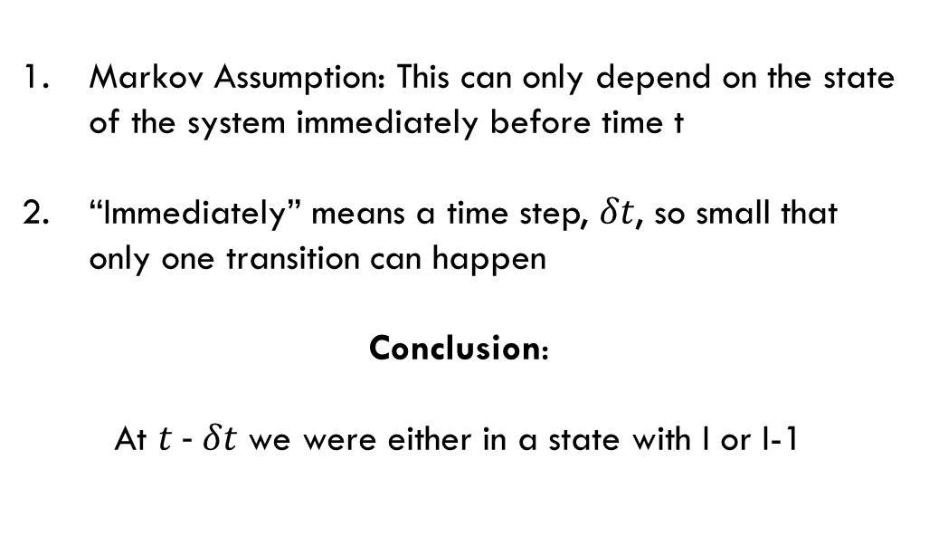
Epidemiology Cont’d
Construction:
Starting with $I_{0}=1$ at$t=0$, we want to know the probability of being in state I at time t
Markov Assumption: This can only depend on the state of the system immediately before time t
“Immediately” means a time step, $δt$, so small that only one transition can happen
Conclusion:
At $t − δt$ we were either in a state with I or I-1
$$P_{I}\left(t\right)=?$$

Slide 34
Epidemiology Cont’d
Construction:
Starting with $I_{0}=1$ at$t=0$, we want to know the probability of being in state I at time t
Markov Assumption: This can only depend on the state of the system immediately before time t
“Immediately” means a time step, $δt$, so small that only one transition can happen
Conclusion:
At $t − δt$ we were either in a state with I or I-1
$$P_{I}\left(t\right)=p_{I|I−1}\left(δt\right)P_{I−1}\left(t−δt\right) +p_{I|I}(δt)P_{I}\left(t−δt\right)$$

Slide 35
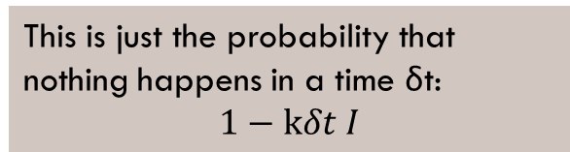
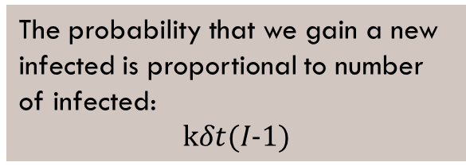
Epidemiology Cont’d
Construction:
Starting with $I_{0}=1$ at$t=0$, we want to know the probability of being in state I at time t
The probability that we gain a new infected is proportional to number of infected:
$$kδt(I−1)$$
Markov Assumption: This can only depend on the state of the system immediately before time t
“Immediately” means a time step, $δt$, so small that only one transition can happen
Conclusion:
At $t − δt$ we were either in a state with I or I-1
$$P_{I}\left(t\right)=p_{I|I−1}\left(δt\right)P_{I−1}\left(t−δt\right) +p_{I|I}(δt)P_{I}\left(t−δt\right)$$
This is just the probability that nothing happens in a time δt:
$$1−kδt I$$

Slide 36
Epidemiology Cont’d
Construction:
Starting with $I_{0}=1$ at$t=0$, we want to know the probability of being in state I at time t
The probability that we gain a new infected is proportional to number of infected:
$$kδt(I−1)$$
Markov Assumption: This can only depend on the state of the system immediately before time t
“Immediately” means a time step, $δt$, so small that only one transition can happen
Conclusion:
At $t − δt$ we were either in a state with I or I-1
$$P_{I}\left(t\right)=kδt(I−1)P_{I−1}\left(t−δt\right) +(1−kδt I)P_{I}\left(t−δt\right)$$
This is just the probability that nothing happens in a time δt:
$$1−kδt I$$

Slide 37
Epidemiology Cont’d
Construction:
Starting with $I_{0}=1$ at$t=0$, we want to know the probability of being in state I at time t
$$P_{I}\left(t\right)=kδt(I−1)P_{I−1}\left(t−δt\right) +(1−kδt I)P_{I}\left(t−δt\right)$$
Rearrange the equation
Left hand side is the definition of a derivative, take limit
Result is a “Master Equation”
$$\frac{P_{I}\left(t\right)−P_{I}(t−δt)}{δt}=k(I−1)P_{I−1}\left(t−δt\right)−kIP_{I}\left(t−δt\right)$$
$$\frac{d}{dt}P_{I}\left(t\right)=k(I−1)P_{I−1}\left(t\right)−kIP_{I}\left(t\right)$$

Slide 38
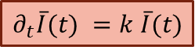
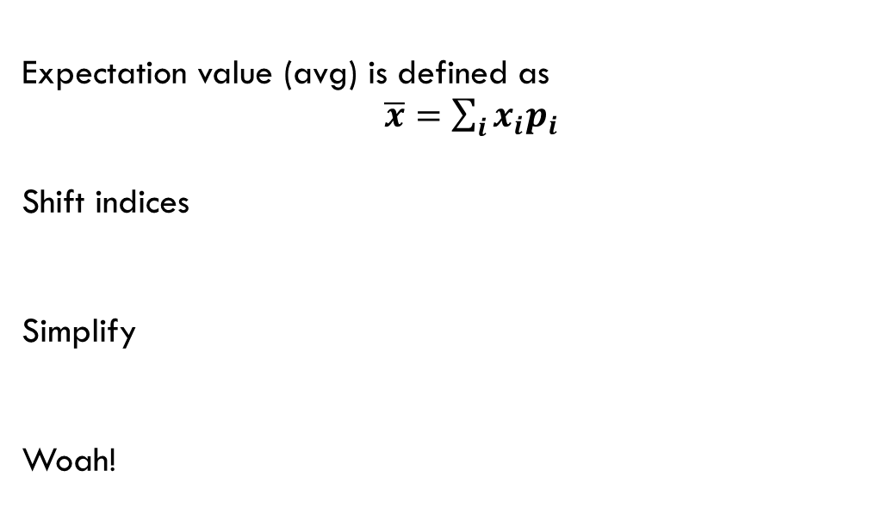
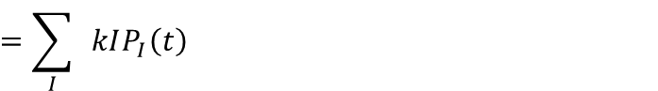
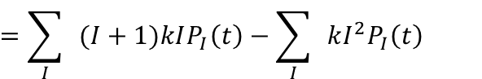
Epidemiology Cont’d
The average solution is the ODE:
We take a quick detour to demonstrate that the mean solution is equivalent to the simple epi ODE
$$\frac{d}{dt}P_{I}\left(t\right)=k(I−1)P_{I−1}\left(t\right)−kIP_{I}\left(t\right)$$
Expectation value (avg) is defined as
$\overline{x}=\sum_{i}{x_{i}p_{i}}$
Shift indices
Simplify
Woah!
$$∂_{t}\overline{I}(t)=\sum_{I}{I}\frac{d}{dt}P_{I}\left(t\right)=\sum_{I}{I}k\left(I−1\right)P_{I−1}\left(t\right)−\sum_{I}{ }kI^{2}P_{I}\left(t\right)$$
$$=\sum_{I}{ }(I+1)kIP_{I}\left(t\right)−\sum_{I}{ }kI^{2}P_{I}\left(t\right)$$
$$=\sum_{I}{ }kIP_{I}\left(t\right)$$
$$∂_{t}\overline{I}(t) =k \overline{I}(t)$$

Slide 39
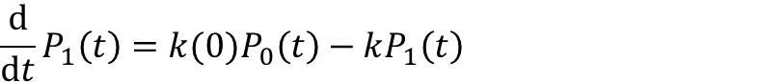
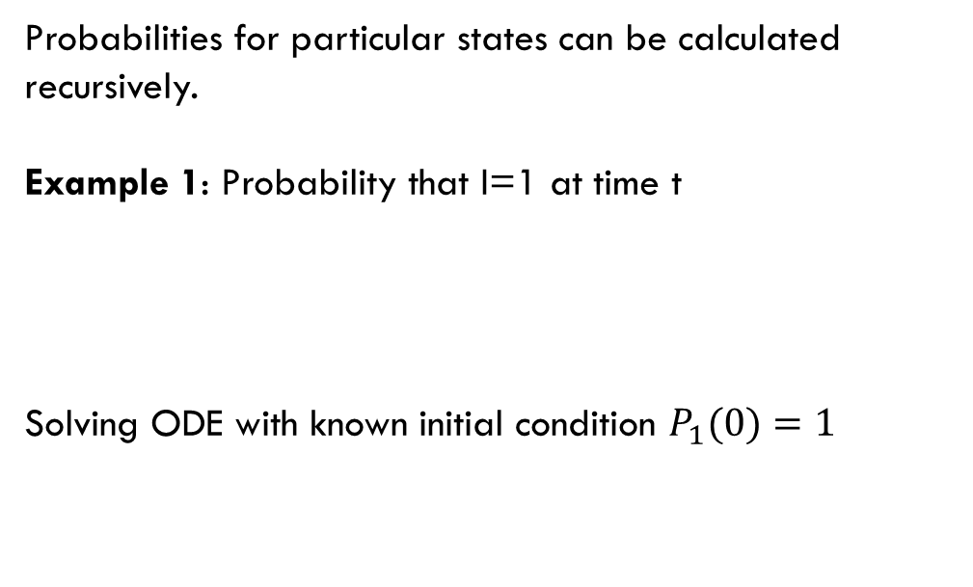
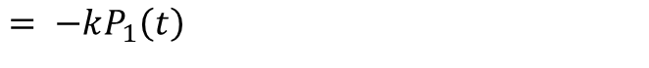
Epidemiology Cont’d
The Master Equation:
Aptly named, the Master Equation is all that’s needed to calculate any statistical quantity
$$\frac{d}{dt}P_{I}\left(t\right)=k(I−1)P_{I−1}\left(t\right)−kIP_{I}\left(t\right)$$
Probabilities for particular states can be calculated recursively.
Example 1: Probability that I=1 at time t
Solving ODE with known initial condition $P_{1}(0)=1$
$$\frac{d}{dt}P_{1}\left(t\right)=k(0)P_{0}\left(t\right)−kP_{1}\left(t\right)$$
$$= −kP_{1}\left(t\right)$$
$$P_{1}\left(t\right)=e^{−k t}$$

Slide 40
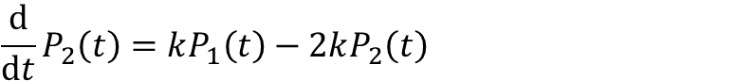
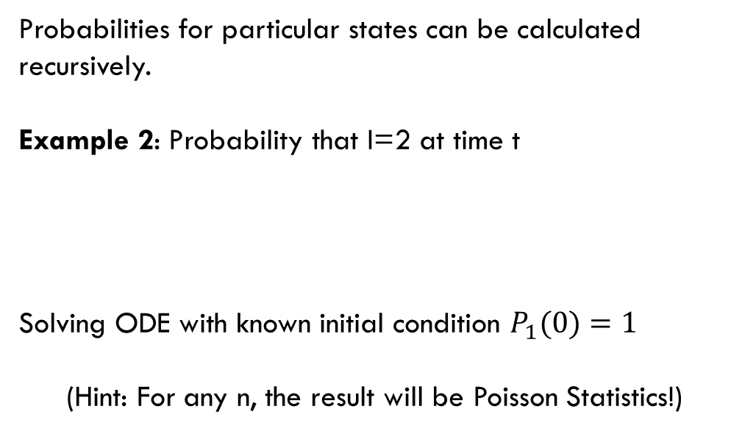
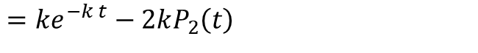
Epidemiology Cont’d
The Master Equation:
Aptly named, the Master Equation is all that’s needed to calculate any statistical quantity
$$\frac{d}{dt}P_{I}\left(t\right)=k(I−1)P_{I−1}\left(t\right)−kIP_{I}\left(t\right)$$
Probabilities for particular states can be calculated recursively.
Example 2: Probability that I=2 at time t
Solving ODE with known initial condition $P_{1}(0)=1$
(Hint: For any n, the result will be Poisson Statistics!)
$$\frac{d}{dt}P_{2}\left(t\right)=kP_{1}\left(t\right)−2kP_{2}\left(t\right)$$
$$=ke^{−k t}−2kP_{2}\left(t\right)$$
$$P_{2}\left(t\right)={\frac{kt}{2} e}^{−k t}$$

Slide 41
Epidemiology Cont’d
The Master Equation:
Most importantly, the Master Equation is an Algorithm
$$\frac{d}{dt}P_{I}\left(t\right)=k(I−1)P_{I−1}\left(t\right)−kIP_{I}\left(t\right)$$
Once you have the Master Equation, you merely have to translate it to code.
These are extremely useful tools for any simulation work.
for t in range(1,t_max):
random_number = random.random()
if random_number>(1-k*I[t-1]):
I[t]= I[t-1]+1
else:
I[t]=I[t-1]

Slide 42
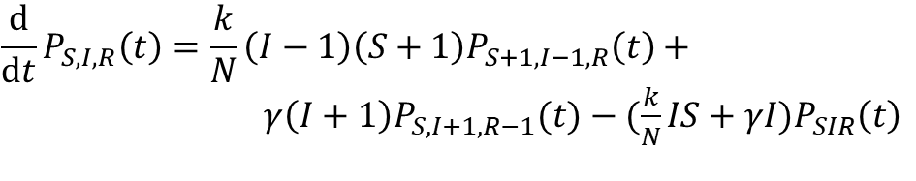
Epidemiology Cont’d
SIR Master Equation:
Be sure to derive this in the group notebook!
It looks complicated but deriving this following the simple case is an instructive and clarifying exercise.
This will be the starting point for your algorithm!
Once you understand how to derive this, developing variations will be simple
$$\frac{d}{dt}P_{S,I,R}\left(t\right)=\frac{k}{N}\left(I−1\right)\left(S+1\right)P_{S+1, I−1,R}\left(t\right)+$$
$γ\left(I+1\right)P_{S,I+1, R−1}(t)−(\frac{k}{N}IS+γI)P_{SIR}\left(t\right)$

Slide 43
Epidemiology Cont’d
SIR Master Equation:
Be sure to derive this in the group notebook!
Suggested Variations
Same as ODE version, sans the spatial dependence (this is a shockingly difficult extension)
Statistical analysis is easy, can show how variance changes with different initial conditions, extensions
Stochastic mutant growth and spread (*)
More advanced studies (potentially publication worthy) for highly motivated students with programming experience are possible
$$\frac{d}{dt}P_{S,I,R}\left(t\right)=\frac{k}{N}\left(I−1\right)\left(S+1\right)P_{S+1, I−1,R}\left(t\right)+$$
$γ\left(I+1\right)P_{S,I+1, R−1}(t)−(\frac{k}{N}IS+γI)P_{SIR}\left(t\right)$

Slide 44
Epidemiology Cont’d
Two basic numerical methods:
We can take uniform steps in time or take Poisson steps in time. Below are basic loops for simple exponential growth. You must convert them to SIR simulations
Discrete time Markov Chain
Continous Time Markov Chain
%% time step of 1 minute
dt= 1/(24*60)
t_max = max_days*dt
%% for loop
for t in range(1,t_max):
random_number = random.random()
if random_number>(1-dt*k*I[t-1]):
I[t]= I[t-1]+1
else:
I[t]=I[t-1]
%% Now Plot I v.s. t
while t[-1] < tmax:
%% Calculate next time that
%% *something* happens
r= random.random()
k_t= k*I[-1]
t_next = - math.ln(1.0 – r)/k_t
t.append(t[-1]+t_next)
%% The only thing that can happen is
%% someone gets infected
I.append(I[-1]+1)
%% Now Plot I v.s. t

Slide 45
This week’s Agenda
!! Decide which method you want to pursue !!
In the Group Notebook:
Derive SIR models (ODE people)
Derive the Master Equations (Markov people)
Research possible implementations (ODE) or devise a for-loop in pseudocode (Markov) and summarize how these work, possible issues etc.
Find some sources of data that you will later compare your model to, think about fitting
Do some writing to summarize the project so e.g. another person in this course would be able to follow the notebook
On your own:
Start working on your basic algorithm and test proposed approaches
Try to write good code that is well-commented can be augmented easily
Try to get to a point where you can produce graphs for S, I, and R.
Attempt fitting some data to extract R₀

Slide 46
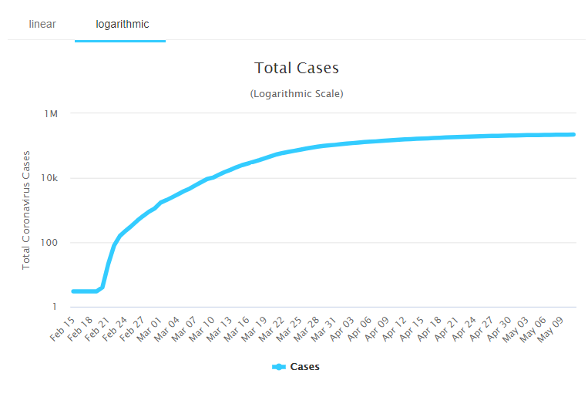
Quick Comment on Fitting

Slide 47
Quick Comment on Fitting
LOCK
DOWN
?
2
weeks

Slide 48
Today
I will stay on Zoom until 5:00 pm to work with everyone and answer questions. We can:
Talk about technical/mathematical details
Look through algorithms together
Search for data sources
Start filling in the group notebook

